Slide 1



Netflix Data Analysis Project
Exploring Netflix's catalog to uncover patterns and trends using Python.
Mahamadhusen Kureshi 07Kureshi@gmail.com

Slide 2

Project Introduction & Objectives
Goal
Scope
Outcome
Analyze Netflix data to reveal actor collaborations, genre ratings, and trends.
Data cleaning, deduplication, and creating supporting tables for detailed analysis.
Provide actionable insights to improve content decisions and viewer satisfaction.

Slide 3






Data Wrangling Workflow
Extract & Load
Import data into the database for processing.
Clean & Structure
Remove duplicates and normalize tables.
Handle Missing Data
Fill gaps in country and duration fields.
Analyze
Run SQL queries to extract insights.
Present
Compile findings into a comprehensive report.

Slide 4

Frequent Actor Collaborations
Actors
Collaboration Count
Notable Projects
Julie Tejwani & Rupa Bhimani
31
Chhota Bheem series
Julie Tejwani & Rajesh Kava
24
Chhota Bheem: Master of S
Rajesh Kava & Rupa Bhimani
22
Chhota Bheem - Neeli Paha

Slide 5
Genre Ratings by Country
Top Rated Genres
Cultural Impact
Sci-Fi & Fantasy in Mexico
Genres reflect cultural preferences and resonate locally.
Horror Movies in Mexico & India
International Movies in South Korea

Slide 6

Directors and Genre Versatility
Versatile Directors
Regional Influence
Anurag Kashyap and Martin Scorsese work across many genres.
Indian directors excel in International Movies and Dramas.
Genre Specialization
Nicolás López focuses on Dramas, Action, and Horror.

Slide 7

Content Popularity Over Time
Early Growth
Post-War Expansion
Few releases before 1940s, reflecting early content stages.
Gradual increase in movie releases after 1945.
Modern Surge
Late 2010s show sharp rise in movies and TV shows.

Slide 8
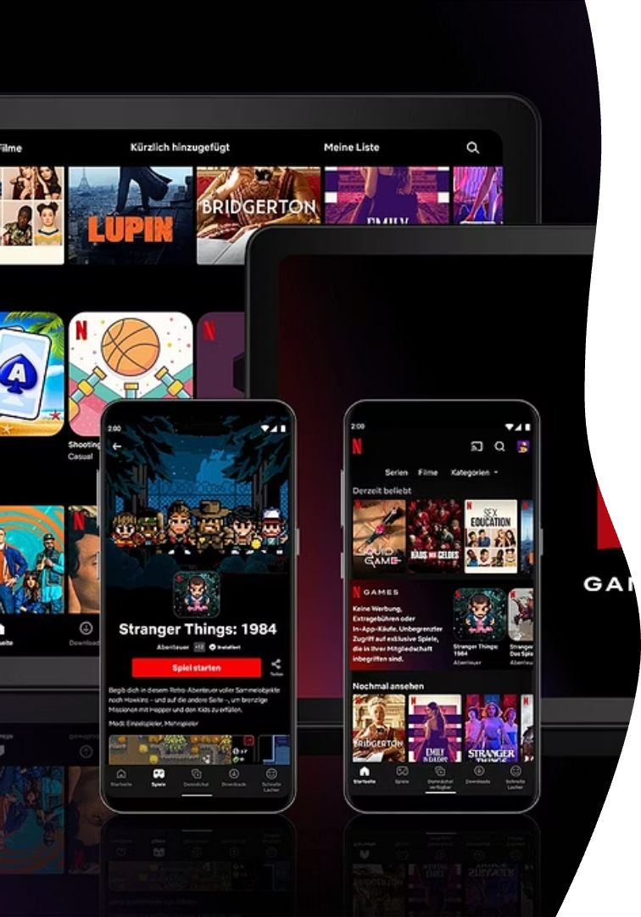
Popular Genre Combinations
Genre Pair
Occurrences
Dramas & International Movies
1483
Comedies & International Movies
804
Dramas & Independent Movies
588

Slide 9

Impact & Recommendations
Leverage Collaborations
Use popular actor pairs to boost viewership and retention.
Targeted Content
Produce genre-specific content for regional preferences.
Promote Genre Pairings
Highlight successful genre combinations in marketing.
Support Independent Films
Focus on niche audiences with artistic, dramatic films.

Slide 10


